Slide 1
EQIPMENT BORROWING
Domain-Driven Design, TDD and Clean Architecture
Group Coursework | Department of Networks, School of Computing and Informatics Technology, Makerere University
Instructor: Kasozi W. Vincent
Member | Role | Leads slides
PRISCILLA | Domain Lead | 1-3
AISHA | Domain Model Lead | 4-6
HOUSNAH | Architecture Lead | 7-9
SAMSON | Testing Lead | 11-12
SAMSON | Integration Lead | 10, 13-15
Notes:
Introduce the group, the domain (equipment borrowing at Makerere colleges) and who leads which slides. Replace the [Name] placeholders with the five member names.

Slide 2
Problem, scope, exclusions and key terms
Problem
Key terms
Duirng Lecturers at Makerere colleges class represenattives borrow equipment such as projectors, HDMI cables and markers for classes. Without clear rules, a borrowing can be approved twice, hold too many items, or be approved for equipment that is under repair.
Term | Meaning
Borrowing | A request to borrow one to three equipment items for a period
Equipment | One specific physical item, such as one projector
Category | Type of equipment (projector, HDMI cable, markers); sets its suspension weight
Borrow period | The start and end dates of a borrowing
Check-out | Marking equipment as taken so no one else can borrow it
Suspension days | Penalty for a late return: days late × category weight
In scope
Approve a borrowing (main use case)
Check out its equipment as a follow-up
Supporting rules: period, lifecycle, contents, late penalty
Out of scope
Money (no fee is paid for late returns)
Applying a suspension to a borrower
Web interface, database, deployment
Notes:
Our domain is equipment borrowing at Makerere colleges. We kept it small: approving a borrowing, then checking out its equipment. We left out money, because no fee is paid for late returns, and we left out applying suspensions, a user interface and a database.

Slide 3
Business rules BR1-BR6
Rule | Statement | Responsible component | Violation outcome
BR1 Value rule | A borrow period lasts 1-14 days; its end falls after its start | BorrowPeriod (value object) | Throws InvalidBorrowPeriod
BR2 State rule | A borrowing moves only Requested, Approved, Returned | Borrowing (aggregate root) | Throws InvalidBorrowState
BR3 Invariant rule | A borrowing holds 1-3 distinct equipment items | Borrowing (aggregate root) | Throws InvalidBorrowingContents
BR4 Cross-concept rule | Suspension days = days late × category weight | LateReturnPolicy (domain service) | Throws UnknownEquipmentCategory
BR5 Follow-up rule | After approval, the equipment must be checked out | BorrowingApproved event and handler; Equipment enforces availability | Equipment throws EquipmentNotAvailable; outcome APPROVED_BUT_CHECKOUT_FAILED
BR6 Lookup rule | A borrowing must exist before it can be approved | BorrowingRepository and ApproveBorrowingService | Returns BORROWING_NOT_FOUND
Domain objects throw exceptions; the application service converts them into outcomes.
Notes:
Go through the rules in order and name the concept each leads to: BR1 Value Object, BR2 Entity, BR3 Aggregate, BR4 Domain Service, BR5 Domain Event, BR6 Repository and Application Service.

Slide 4
Value Object and Entity choices
Value Object: BorrowPeriod (BR1)
Entities (BR2)
Holds a start date and an end date
Valid only if it lasts 1-14 days and the end is after the start; otherwise it throws InvalidBorrowPeriod
No separate identity: two periods with the same dates are interchangeable
Immutable: changing a period means creating a new, validated one
Entity | Identity | What changes
Borrowing | Borrowing ID | Status: Requested, Approved, Returned (BR2)
Equipment | Equipment ID | Status: Available, Checked out, Under repair
Identity matters because the same borrowing or the same projector must be tracked as its state changes.
Notes:
Test used: does it matter which exact one it is? For a borrow period it does not, so it is a Value Object. For a borrowing or a projector it does, so they are Entities with IDs. Borrowing carries the BR2 lifecycle.

Slide 5
Aggregates A and B
 | Aggregate A | Aggregate B
Root | Borrowing | Equipment
Contents | BorrowPeriod and a list of equipment IDs | Its category and its status
Invariant protected | 1-3 distinct items, never a duplicate (BR3) | Can be checked out only when Available
Violation | InvalidBorrowingContents | EquipmentNotAvailable
All changes go through the root; outside code never edits the contents directly
Borrowing refers to equipment by ID only, never by holding the Equipment object
The two aggregates are linked only by the BorrowingApproved event (slide 10)
Notes:
Borrowing is the root of Aggregate A and protects BR3. Equipment is the root of Aggregate B and protects its own rule: only Available equipment can be checked out. They are separate so neither can break the other's rule; the event is the only link.

Slide 6
Domain Service and Factory decision
Domain Service: LateReturnPolicy (BR4)
Factory: not used
Suspension days = days late × category weight. Example: a projector returned 3 days late gives 3 × 2 = 6 suspension days.
Creating a Borrowing has no rules beyond its constructors: BorrowPeriod validates itself and Borrowing checks its own contents (BR3)
A factory would only wrap a simple constructor, adding a pattern without a reason
We would add one if creation needed several steps at once, such as generating an ID, loading equipment and checking availability
Category | Weight
Projector | 2
HDMI cable | 1
Markers | 1
Days late come from the borrowing; the weight comes from the equipment category, so the rule fits neither entity
Stateless: it only calculates and does not apply the suspension
Unknown category throws UnknownEquipmentCategory
Notes:
BR4 needs two facts from different places: dates from the borrowing and the weight from the equipment category. Putting it on either would make that object know about the other, so it is a domain service. We did not use a factory because creation has no extra rules.

Slide 7
Repositories
Repository (Application) | In-memory version (Infrastructure) | Stores | Used by
BorrowingRepository | InMemoryBorrowingRepository | Borrowing roots (Aggregate A) | ApproveBorrowingService (BR6 lookup)
EquipmentRepository | InMemoryEquipmentRepository | Equipment roots (Aggregate B) | CheckOutEquipmentOnApproval handler
One repository per aggregate root used in the workflow; none for the value object or the domain service
The abstractions live in Application because the use case needs them; Infrastructure implements them, so the dependency points inward
The in-memory versions are dictionaries keyed by ID; get() returns nothing when the ID is missing
Moving to a database later would change only Infrastructure
Notes:
One repository per aggregate root. The abstractions are in Application, the dictionary-based versions in Infrastructure. Value objects and the domain service have no repositories because they are not aggregate roots.

Slide 8
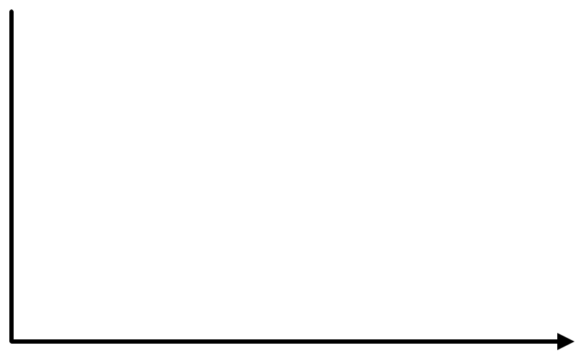

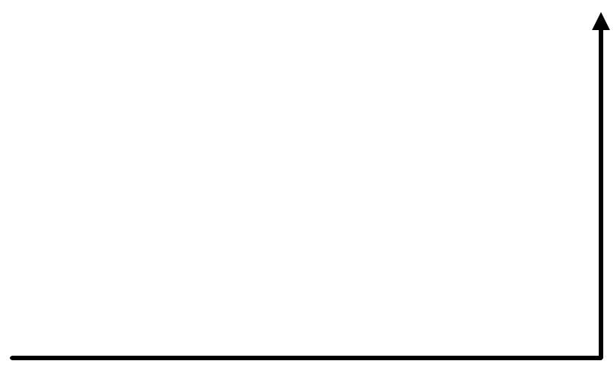
Clean Architecture diagram
Interface
Application
Domain
main.py (console)
ApproveBorrowingService, DTOs, repository and dispatcher interfaces, CheckOutEquipmentOnApproval handler
BorrowPeriod, Borrowing, Equipment, LateReturnPolicy, BorrowingApproved, exceptions, Entity, AggregateRoot
Infrastructure
In-memory repositories, in-process event dispatcher
Arrows mean "imports from". Every arrow points toward Domain, and business rules live only in Domain.
Notes:
Four layers. Domain holds all business rules and imports nothing. Application holds the use case, DTOs and repository interfaces and depends only on Domain. Infrastructure implements those interfaces and depends on Application and Domain. Interface is main.py, which wires everything together.

Slide 9
Application Service, DTOs and dependency injection
ApproveBorrowingService (coordination only)
DTOs
Receive ApproveBorrowingRequest
Look up the borrowing (BR6); if missing, return BORROWING_NOT_FOUND
Call borrowing.approve(); the aggregate enforces BR2 and BR3
Save the borrowing
Dispatch the BorrowingApproved event (BR5)
Return ApproveBorrowingResponse
DTO | Fields
ApproveBorrowingRequest (input) | borrowing_id
ApproveBorrowingResponse (output) | borrowing_id, outcome, status
Outcomes: APPROVED_AND_CHECKED_OUT, APPROVED_BUT_CHECKOUT_FAILED, BORROWING_NOT_FOUND, INVALID_STATE
No business rules here; it only converts domain exceptions into outcomes.
Dependency injection
Layer Supertype: used
Repositories and the dispatcher are passed into the service constructor, never created inside it
main.py builds the in-memory versions and injects them; the tests do the same with fresh copies
Entity and AggregateRoot are shared base classes in Domain; Borrowing and Equipment extend AggregateRoot.
Notes:
The service only coordinates: lookup, call the aggregate, save, dispatch, respond. Rules stay in the aggregates. DTOs keep domain objects away from the interface, and everything the service depends on is injected from outside.

